Slide 1
Introduction to LangGraph: A Modern Guide to Graph-Based Agent Workflows
Master graph workflows for automation and practical use
Notes:
AI-generated content may be incorrect. --- Welcome to this presentation on LangGraph, a comprehensive guide to understanding and mastering graph-based agent workflows. We will explore key concepts such as graph basics, workflow automation, and practical applications to enhance your skills and career opportunities.

Slide 2
Presentation Agenda
Introduction and Program Overview
Fundamental Concepts and Workflow Automation
Data Structures and Workflow Management
Learning Experience and Career Advancement
Certification and Program Benefits
Notes:
This presentation covers an introduction and overview of LangGraph, fundamental concepts of graph-based workflows, data structures and workflow management, learning experiences and career advancement, and the certification benefits you can gain from the program.

Slide 3
Introduction and Program Overview
Notes:
This section introduces the core objectives of LangGraph, including learning graph-based agent workflows and understanding state transitions. We will also start with graph basics covering nodes, edges, and vertices to build a strong foundation.

Slide 4
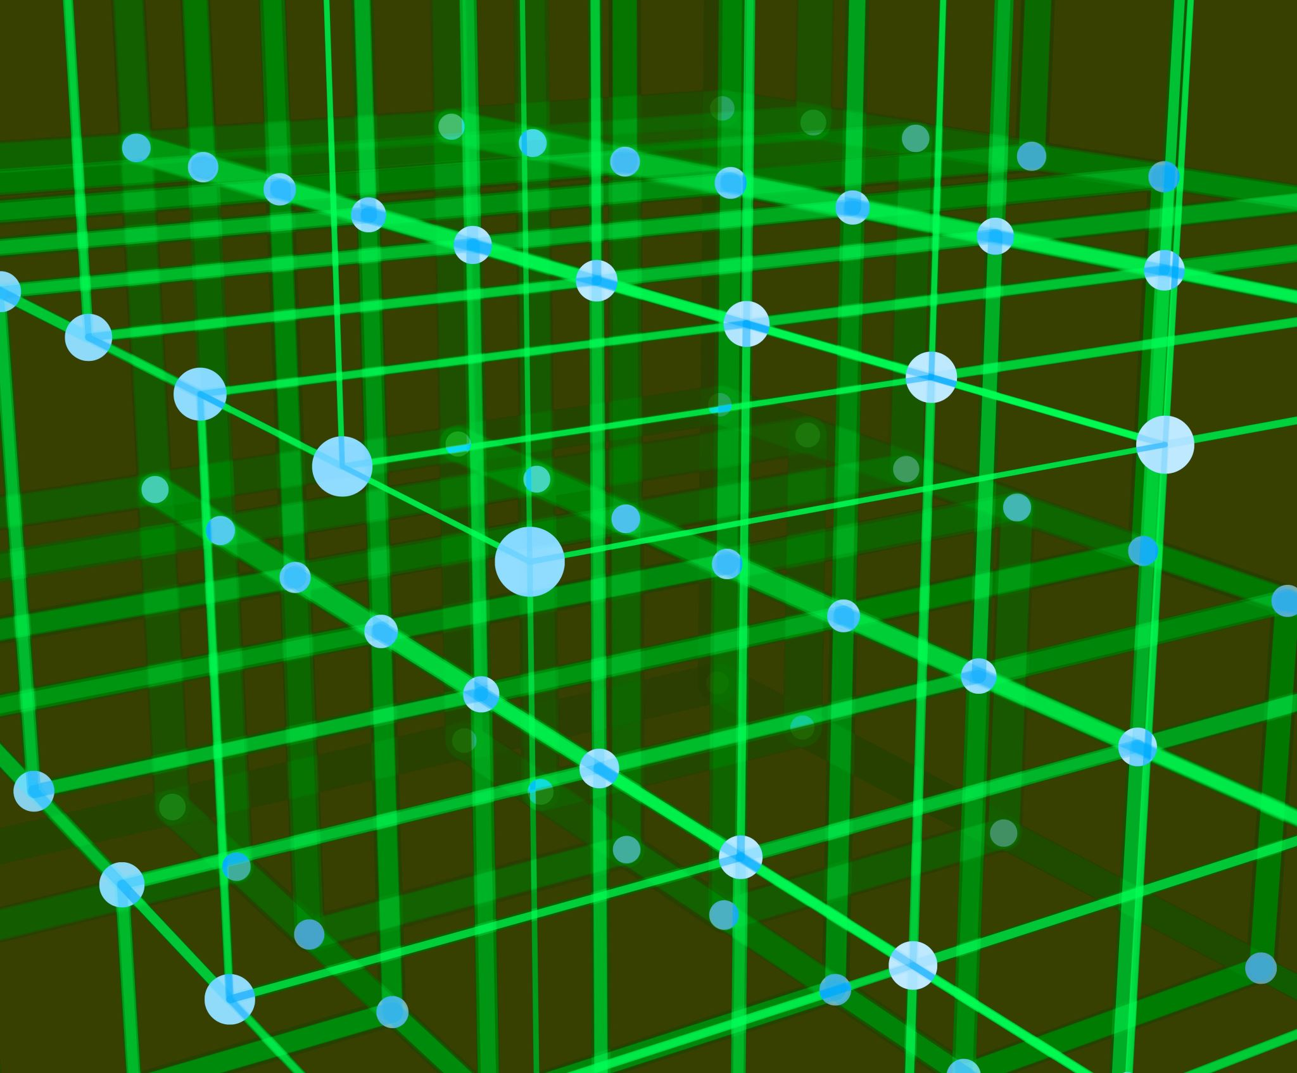
Title Slide with Modern Abstract Graph Image
Graph Theory Foundations
Interconnected nodes and edges illustrate the fundamental concepts of graph theory.
Agent Workflow Modeling
Graph structures provide a visual model for LangGraph’s agent workflow processes.
Notes:
--- The modern abstract graph image represents the interconnected nodes and relationships that form the foundation of graph theory, which is central to LangGraph's approach to agent workflows. Image source: Microsoft 365 content library

Slide 5

Purpose: Learning Graph-Based Agent Workflows and State Transitions
Graph-Based Agent Workflows
Agents use graph-based workflows to define sequences of tasks and decision points for efficient operation.
State Transitions in Agents
State transitions manage the flow of data and tasks, allowing agents to progress through different operation stages.
Notes:
--- The purpose of this program is to enable learners to understand how agents operate using graph-based workflows and how state transitions govern the flow of tasks and data within these systems. Image source: Microsoft 365 content library

Slide 6

Graph Basics: Nodes, Edges, Vertices with Simple Network Visual
Nodes and Vertices
Nodes or vertices represent entities or points in a graph, serving as fundamental units of data.
Edges and Connections
Edges are links or connections between nodes, representing relationships or interactions.
Network Visualization
A simple network diagram visually illustrates how nodes and edges form a graph structure.
Notes:
--- Graphs consist of nodes (or vertices) connected by edges. Understanding these elements is key to modeling relationships and workflows in LangGraph, which we illustrate with a simple network diagram. Image source: Microsoft 365 content library

Slide 7
Fundamental Concepts and Workflow Automation
Notes:
This section delves deeper into the relationships represented in graphs, the automation of agent workflows, and the dynamics of state transitions that drive task execution.

Slide 8

Relationships: Representing Connections with Linked Data Points Image
Graph Relationships
Relationships link nodes in a graph, forming connections that represent data associations.
Data Traversal
Linked data points allow agents to efficiently traverse and access interconnected information.
Information Manipulation
Connected data points facilitate manipulation and analysis of complex datasets in graph structures.
Notes:
--- Relationships in graphs connect data points, enabling agents to traverse and manipulate information efficiently. The linked data points image visualizes these critical connections. Image source: Microsoft 365 content library

Slide 9
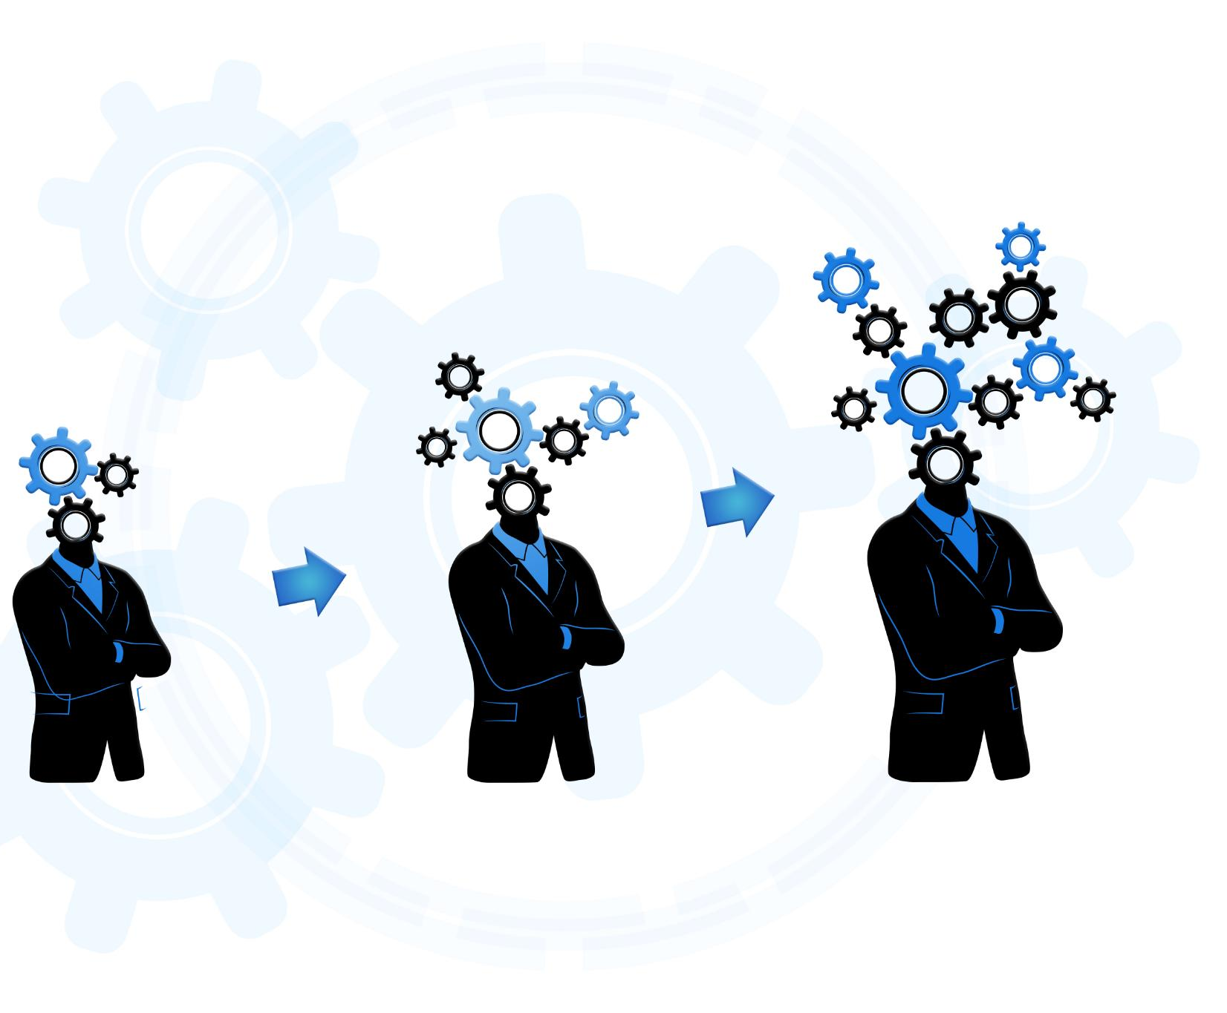
Agent Workflows: Task Execution and Workflow Automation Illustration
Automated Task Execution
Agents automatically execute tasks by following predefined workflows to improve efficiency and accuracy.
Graph Structure Navigation
Agents navigate complex graph structures to manage dependencies and task sequences effectively.
Workflow Optimization
Automation optimizes complex processes by reducing manual interventions and improving throughput.
Notes:
--- Agent workflows illustrate how tasks are executed automatically by agents navigating through graph structures, optimizing complex processes via automation. Image source: Microsoft 365 content library

Slide 10
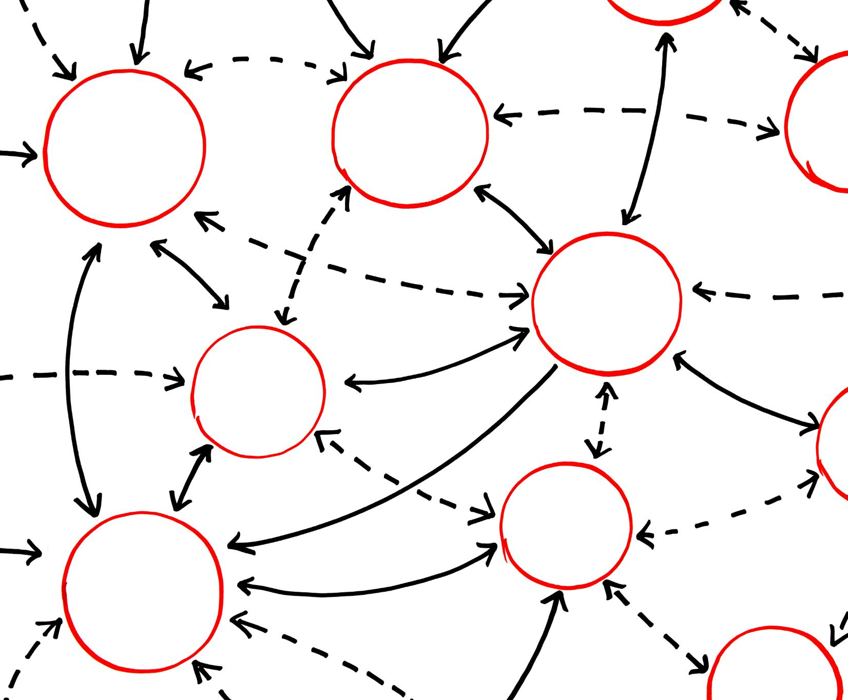
State Transitions: Push Vs. Pull, Diagram of State Changes
Understanding State Transitions
State transitions define how agents change states based on triggers in a system or workflow.
Push Model Concept
In the push model, state changes are triggered by external data or events pushing updates to agents.
Pull Model Concept
In the pull model, agents request or pull data updates to trigger their own state changes.
Notes:
--- State transitions dictate how agents move between states. We explore push and pull models with a diagram showing how data and control flows trigger changes within workflows. Image source: Microsoft 365 content library

Slide 11
Data Structures and Workflow Management
Notes:
Understanding graph data structures and effective workflow management techniques is essential for implementing LangGraph solutions successfully.

Slide 12
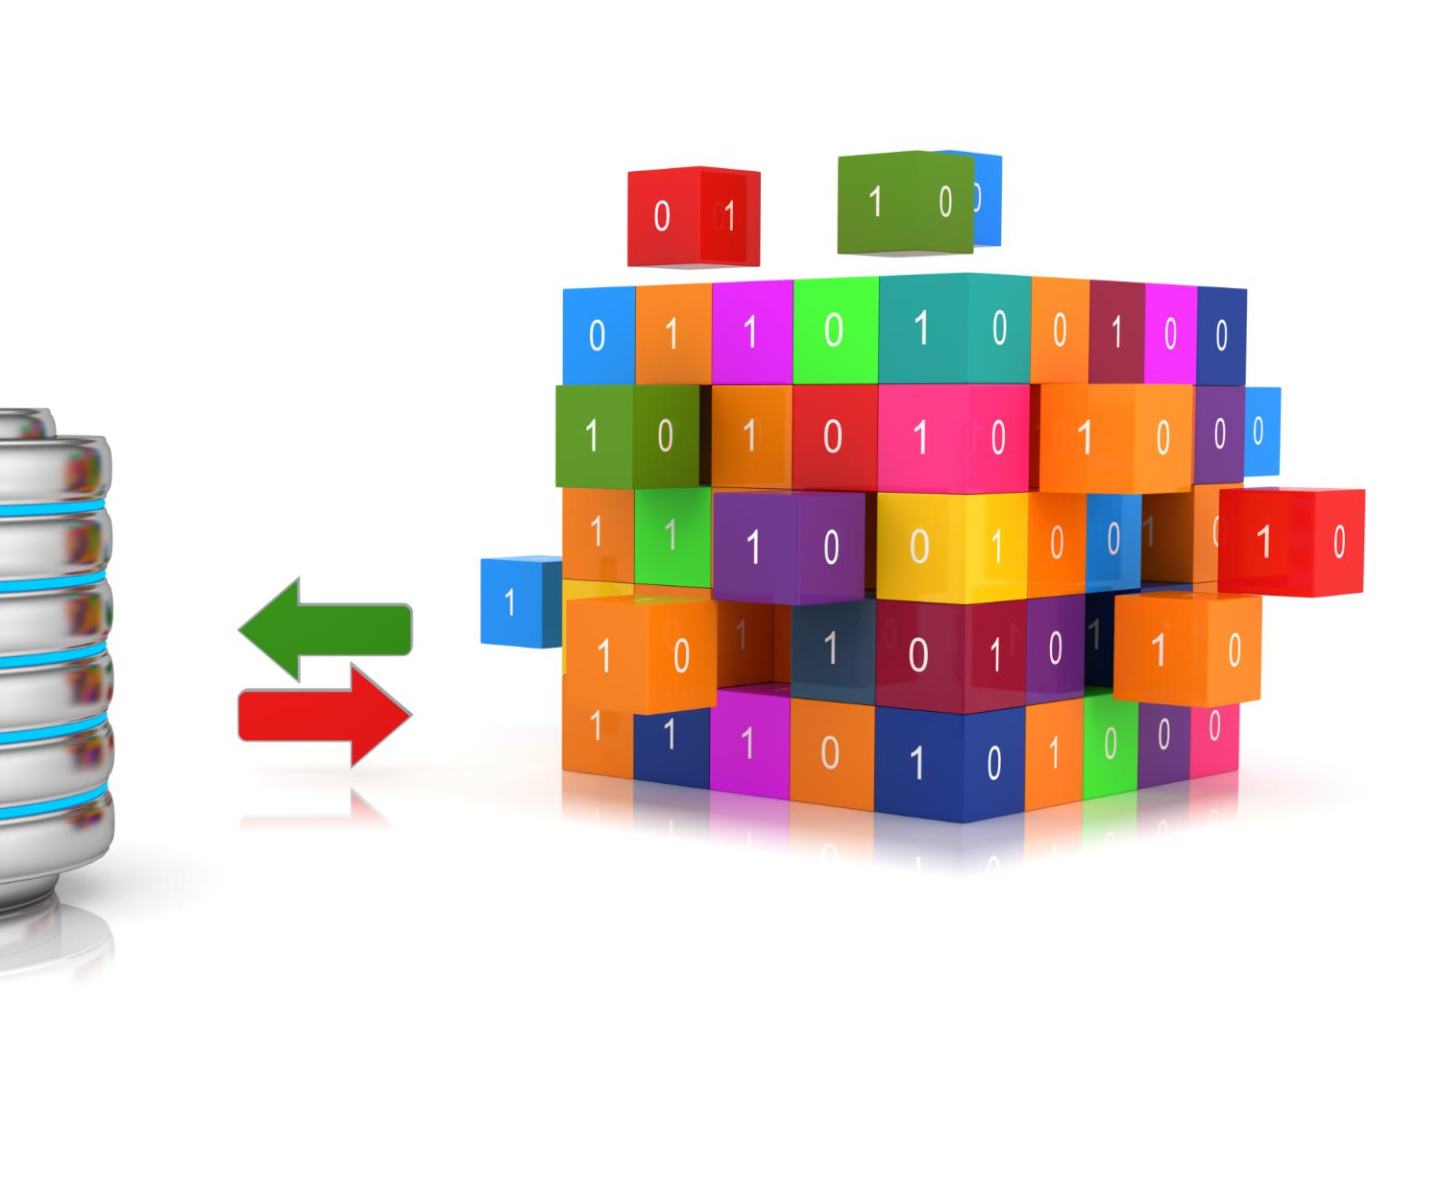
Graph Data Structures: Adjacency Lists, Matrices, Databases with Storage Image
Adjacency Lists
Adjacency lists store graph edges as lists, optimizing memory for sparse graphs and improving traversal efficiency.
Adjacency Matrices
Adjacency matrices use 2D arrays to represent edges, offering fast edge lookup but higher memory usage for sparse graphs.
Graph Databases
Graph databases store graph data enabling complex queries and scalability, enhancing performance in large datasets.
Notes:
--- Graphs can be stored using various data structures such as adjacency lists and matrices, or specialized graph databases. These structures impact performance and scalability. Image source: Microsoft 365 content library

Slide 13
Workflow Management: Best Practices and Flowchart Visual
Clear Task Definitions
Clear task definitions ensure roles and responsibilities are well understood for efficient workflow execution.
Error Handling
Effective error handling mechanisms reduce workflow disruptions and improve process reliability.
Optimization Strategies
Optimization strategies streamline processes to increase productivity and minimize resource use.
Notes:
Best practices in workflow management include clear task definitions, error handling, and optimization strategies, illustrated here with a detailed flowchart.

Slide 14

Case Studies: Real-World Applications and Team Collaboration Image
Collaborative Problem Solving
Teams use LangGraph workflows to address complex problems through effective collaboration and communication.
Workflow Efficiency
LangGraph workflows streamline processes, enabling teams to work efficiently and achieve better outcomes.
Notes:
--- Real-world case studies demonstrate how teams leverage LangGraph workflows to solve complex problems collaboratively and efficiently. Image source: Microsoft 365 content library

Slide 15
Learning Experience and Career Advancement
Notes:
This section focuses on the experiential learning opportunities and how mastering LangGraph can advance your professional career.

Slide 16

Project-Based Learning: Building Workflow Projects with Coding Image
Hands-on Learning
Engaging with real projects allows learners to understand concepts deeply through practical application.
Real-World Workflows
Building workflows simulates real industry tasks enhancing problem-solving and coding skills.
Knowledge Reinforcement
Practical coding exercises solidify theoretical knowledge and improve retention.
Notes:
--- Hands-on projects enable learners to apply concepts by building real-world workflows, reinforcing knowledge through practical coding exercises. Image source: Microsoft 365 content library

Slide 17
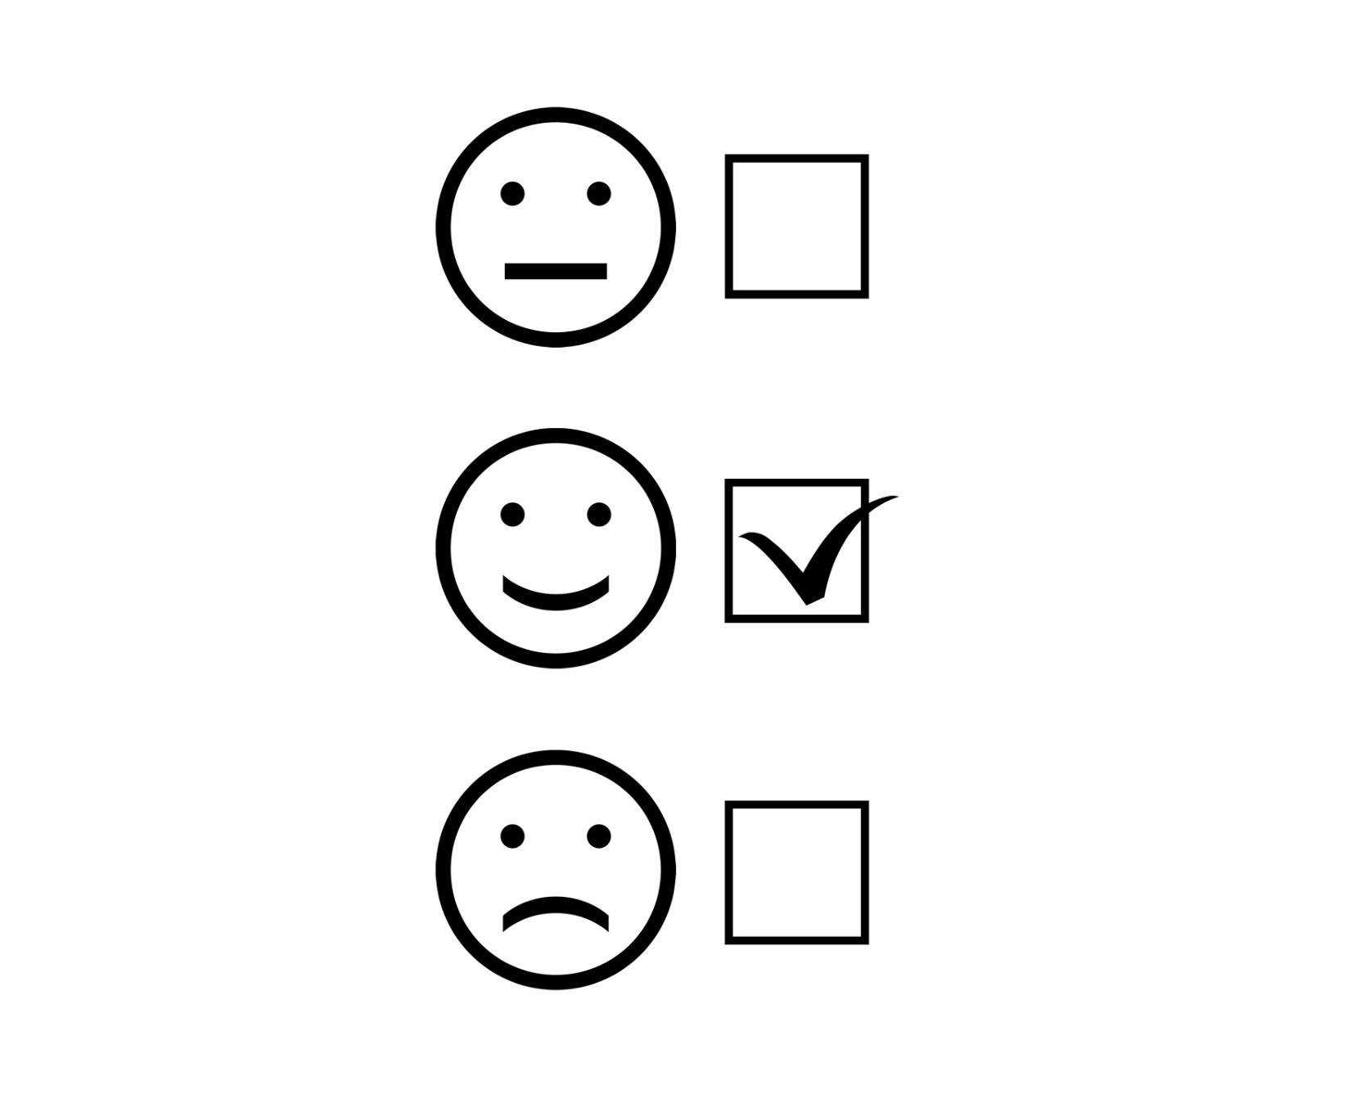
Assessment: Quizzes, Evaluations, Exam or Checklist Image
Purpose of Assessment
Assessments help learners track their progress and reinforce understanding of graph-based workflows.
Types of Assessment
Quizzes and evaluations provide varied methods to measure knowledge and skills effectively.
Benefits of Evaluation
Evaluations solidify learner comprehension and highlight areas needing improvement.
Notes:
--- Assessment through quizzes and evaluations ensures learners track their progress and solidify their understanding of graph-based workflows. Image source: Microsoft 365 content library

Slide 18
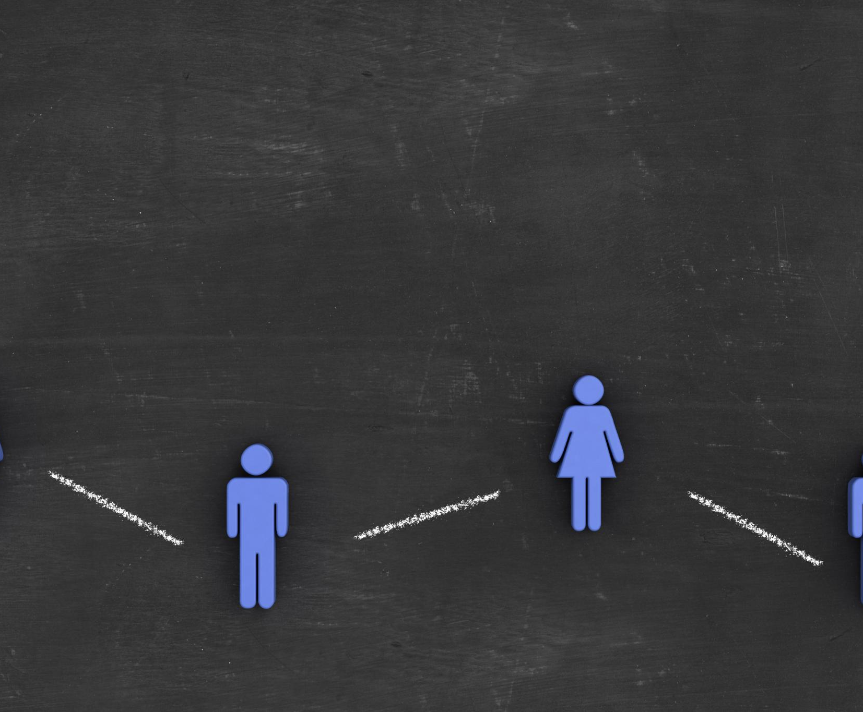
Community Participation: Discussions, Forums, Social Media Image
Community Engagement
Active participation in forums and social media strengthens community bonds and encourages knowledge sharing.
Supportive Learning Environment
Social media and forum interactions provide continuous support and motivation for learners throughout their journey.
Notes:
--- Engagement with the LangGraph community via forums and social media fosters knowledge sharing and support throughout the learning journey. Image source: Microsoft 365 content library

Slide 19
Certification and Program Benefits
Notes:
The final section highlights the certification process and the many benefits of completing the LangGraph program, including career growth and skill development.

Slide 20

Certification: LangGraph Credential and Certificate Image
Certification Purpose
LangGraph certification validates expertise in graph-based agent workflows for professional recognition.
Achievement Recognition
Successful learners receive a formal certificate signifying mastery of LangGraph technologies.
Notes:
--- Upon successful completion, learners receive a LangGraph certification that validates their expertise in graph-based agent workflows. Image source: Microsoft 365 content library

Slide 21

Benefits: Career Growth, Skill Development with Professional Visual
Career Advancement Opportunities
Certification creates new pathways for career growth and leadership roles in technology fields.
Technical Skill Enhancement
Obtaining certification improves and updates technical knowledge and practical skills.
Increased Professional Credibility
Certified professionals gain trust and recognition from employers and peers.
Notes:
--- Certification opens doors to career advancement opportunities, enhances technical skills, and increases professional credibility in the rapidly evolving tech landscape. Image source: Microsoft 365 content library

Slide 22

Conclusion: Recap and Inspiring Network Connections Image
Modern Graph Workflows
LangGraph provides a practical pathway for mastering advanced graph-based workflows effectively.
Empowering Connections
Building connections through LangGraph enhances skills to foster innovation and career success.
Notes:
--- To conclude, LangGraph offers a modern, practical pathway to mastering graph-based workflows. The connections and skills gained will empower you to innovate and succeed in your career. Image source: Microsoft 365 content library

Slide 23
Conclusion
Appreciation and Farewell
Express gratitude to the audience for their time and engagement with LangGraph concepts.
Inspiration to Explore
Encourage deeper exploration of graph-based agent workflows for enhanced knowledge and skills.
Professional Growth
Highlight the potential of leveraging these concepts for career advancement and success.
Notes:
Thank you for exploring LangGraph with us. We hope this guide inspires you to dive deeper into graph-based agent workflows and leverage these concepts for your professional growth and success.

